Slide 1
Recent immunisation Comms & Engagement Research
22 June 2023

Slide 2
In the beginning
A year ago (DPMC Research)
Currently (TRA)
COVID kept out
Everyone fairly compliant
Team of 5 million, for the good of the county
BUT
Not everyone on board – some very anxious or indecisive about getting the vaccine (refer personas)
Mandates forced people to get two doses
Estimate between 15% - 35% did not choose to have two doses but ‘had to’ for work or to get a vaccine pass
COVID-19 fatigue rising
NZers have more concerns than ever, cost of living #1
More negative emotions associated with COVID e.g. sad and angry
New Zealand more divided
Some have moved on, others think response not enough and others just fed up
Many have had COVID, meaning less concerned, less motivated/willing to comply and less likely to get vaccinated
Majority think most people will get it at some point
Only half think booster shots needed to keep immunity up
A quarter think all the messages and advertising about COVID-19 vaccinations has made my whānau less likely to get other vaccinations, particularly those who have children
Global uncertainty, fear of instability
Natural disasters (particularly in areas of high risk)
Cost of living is the major concern
Volatility of emotions increased – anxious, concerned, uncertain, angry, fearful
Mental health getting worse
In situations of uncertainty = fight, flight, freeze (can the same apply to vaccine decisions?)
Decisions made in times of uncertainty create long term memories – the experience they have is very important
Source: TRA DPMC July 2022 Behaviour and Sentiment Tracker, TRA Sunrise Session Presentation

Slide 3
Inflation/ cost of living still #1 issue
Source: Ipsos | NZ Issues Monitor May 23

Slide 4
Additional context for Māori
Additional context for Pacific
The feeling of not be listened to or empowered in the earlier stages of the COVID-19 response.
A definite sense of being ‘sick of being told what to do’ – make own choices.
Motivations and barriers show a lack of engagement with flu and some distrust of public health messaging.
A ‘hunker down’ approach as a way of self protection to COVID-19 which may apply to flu.
A community lead approach with GPs that encompasses whanau is even more important, both for influencing and making vaccination easy and accessible.
A Māori for Māori approach will be most powerful for those in particular who are strongly connected to their whakapapa: ‘for us, about us, with us and by us, in our way.’
There is a sensitivity for Pasifika to feeling targeted and seen as the ‘failed group.’
There is a slight back lash to the use of cultural values for marketing health especially ‘doing x to protect our community’. The protection of the collective is intrinsic to Pasifika culture – seeing the message used for health messages is wearing thin.
Pasifika have also felt the damage from misinformation – they are more likely now to keep their information sources closer to home within trusted community and health networks.
Cost is a barrier, including costs involved in taking time off work.
Trusted information (and access) through GPs and community will be critical to avoid misinformation or distrust. Communications need to target local networks and create stories that can be told – trusted WOM is especially important.
There is a need to plug information gaps for Pasifika, particularly in terms of the role of vaccinations and boosters moving forward - why is it important?
Source: State of Nation Flu April 2022/ Booster Reframe August 2022

Slide 5
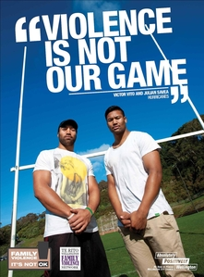
Added complexity in that Māori and Pasifika are getting tired of being singled out by government messaging
“They need to stop stereotyping us, we don’t all dress in hoodies and live in over-crowded housing” (Pasifika)
“They need to target all communities not just Māori as it's easy to assume this is just a Māori problem”
(Gen pop)
What will be less likely to motivate
Singling out Māori in communications unless by Māori for Māori
Reinforcing stereotypes e.g. in COVID style production values or "Guilt tripping"
Source: MMR Catch up cohort November 2022

Slide 6
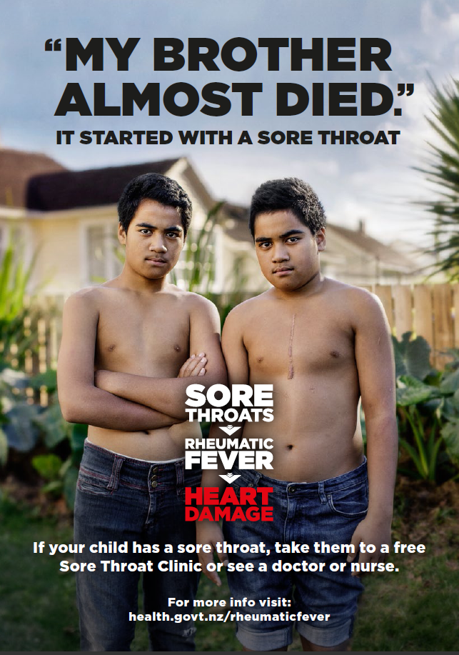
And when triggering motivation these two ads provide key learnings for our messages
Ad works well because…
…it offers some shock factor with a clear mental short cut without over dramatising
…focuses on a positive survivor story that works effectively for this age group
…has authenticity by focusing on real people not actors.
“The two brothers, it’s really effective because it says tells the story and it’s bold and powerful, it’s real. It would suit a story around rubella and mumps around fertility – everyone would be like oh gosh.” (Pasifika)
Ad works well because…
…it feels relatable to the age cohort, not just Māori thus not making the issue a Māori only problem like the example on the right.
“The legend ad is brilliant. Most Māori ads are quite condescending.” (Māori)
Source: MMR Catch up cohort November 2022

Slide 7
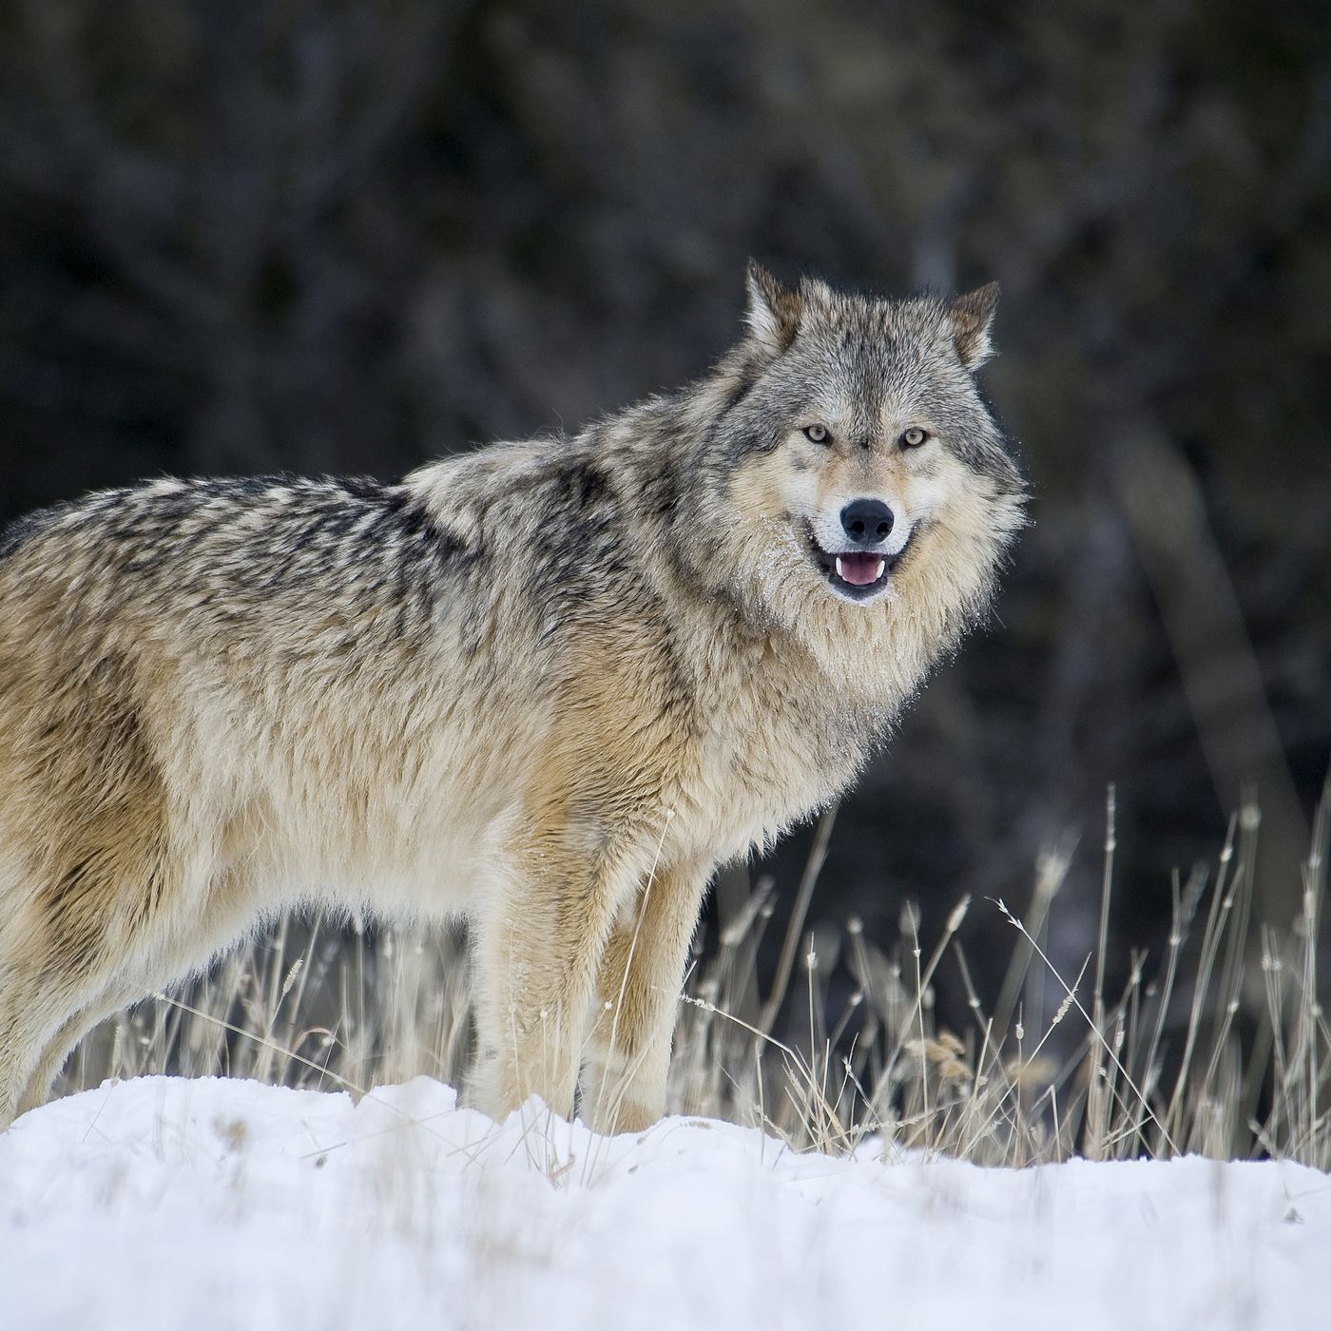
How vaccines are perceived is very different
Childhood immunisations e.g. those for tetanus, polio & mumps are widely accepted & approved treatments.
Feelings on the HPV vaccine fall between the high comfort and trust of infant immunisations and the distrust and uncertainty of COVID-19 ones
Research in Aug 2022 found:
The strongest barriers to childhood imms were concerns about side effects, followed by the belief that some of the vaccinations are unnecessary.
Parents who were uncomfortable with childhood immunisations were most concerned about side effects, testing quality, professed need and claimed effectiveness.
These parents are fearful of what they have heard and feel incapable of making the correct decision, especially when they find the official information difficult to understand.
Fear + a lack of control = inaction.
Māori and low-income parents were more likely to question these vaccines and to find the available information about them difficult to understand.
COVID is an exotic sly predator i.e. a wolf.
Wild, looking for me
Flu is seen as a domesticated animal i.e. a husky.
But, can bite – has serious/dangerous potential
The flu vaccine has been around for a long time and there is a high degree of trust surrounding it.
Influenza is a familiar foe in foreign times
Source: State of Nation Flu April 2022, Seqirus Research re HPV August 2022

Slide 8
Current perceptions towards childhood immunisations

Slide 9
The majority understand the importance of childhood immunisations
 | Total n=1,570 | Māori n=298 | Pacific n=112 | Responsible for a disabled child ≤12 years n=68
Net agree | 81% | 78% | 76% | 66%
Net disagree | 7% | 8% | 6% | 15%
Net agree: 81%
However, those who are responsible for a disabled child 12 years and under were less likely to agree with the statement ‘childhood immunisations are important to protect our children from diseases and getting really sick’.
Other subgroups who were significantly less likely to agree with this statement were:
Younger parents/caregivers 18-34 years (72% net agree vs total population result of 81%)
Single parents with 3 or more children at home (63%)
Those in occupations of business proprietor/self employed (67%)
Those who have lower levels of education (Total NCEA 2 or less, 76%)
Those who have more children under the age of 5 (at least three under the age of five, 64%)
Those who are less likely than a few months ago to get their child immunised if due (37%).
Those living in Wellington were more likely to agree (87% cf. 81%). Those who have seen/ heard something about childhood immunisations or measles were also more likely to agree (84% and 85% respectively).
There were no significant differences by gender, ethnicity, grouped household income levels and urban vs rural.
Net disagree: 7%
Source: Horizon Omnibus May 2023
Q2: To what extent do you agree with the following statements…
Base: All respondents n=1,570
Significantly higher / lower than average

Slide 10
About a quarter of the population 18+ feel more negative about immunisations in general because of the last 2 years
 | Total n=1,570 | Māori n=298 | Pacific n=112 | Responsible for a disabled child ≤12 years n=68
Net agree | 23% | 28% | 29% | 48%
Net disagree | 57% | 51% | 36% | 29%
Net agree: 23%
The proportion who feel more negative about immunisations in general (due to the last two years) was significantly higher for those with a disabled child 12 years and under (48%). Māori and Pacific were more likely to disagree they are feel more negatively about immunisations in general (but were not significantly less likely to agree!).
Other subgroups who were significantly more likely to agree/ less likely to disagree the last two years has made them feel more negatively about immunisations in general were:
Younger parents/caregivers 18-34 years (more likely to agree 29% vs total population result of 23%)
Single parents with 3 or more children at home (less likely to disagree 35% cf. 57%)
Those who have more children under the age of 5 (at least three under the age of five, less likely to disagree 29% cf. 57%)
Those whose child is aged 12 and under is less likely to be immunised at all or has had some and they are happy to stop there (more likely to agree 71% and 53% respectively cf. 23%)
Those who are less likely than a few months ago to get their child immunised (more likely agree 57% cf. 23%).
Those living in Wellington were more likely to disagree they are more negative (68% cf. to 57%), likewise those who have a degree or higher qualification (67%). Those who have seen/ heard something about childhood immunisations or measles were also more likely to disagree they are more negative about immunisations in general (64% and 64% respectively compared to 57% total). There were no significant differences by gender, and urban vs rural.
Net disagree: 57%
Source: Horizon Omnibus May 2023
Q2: To what extent do you agree with the following statements…
Base: All respondents n=1,570
Significantly higher / lower than average

Slide 11
Why have views changed (for those who are less likely to get their Child Immunised)?
While there were a range of answers for this question, some of the main themes for those who were slightly less likely/much less likely than a few months ago to get their child immunised (if they were due an immunisation) included… the impact of COVID, a lack of trust/ loss of faith in the government and concerns re side effects.
“Can not trust health providers since Covid.”
(Much less likely, Female, 35-44 years, Māori)
“I've realised the Ministry of Health do not tell the truth.”
(Much less likely, Female, 35-44 years, European)
“All this pushing the phizer "vaccine" when it doesn't stop the transmission or reduce symptoms.”
(Slightly less likely, Male, 35-44 years, European)
“Just unsure about chemicals going into our bodies. I've heard many stories about the vaccine creating more problems people never had before. So I'm not sure now.”
(Slightly less likely, Female, 35-44 years, Pacific)
“The pressure, being treated inhumanly, the latest vaccine related injuries, the lies, corruption, the mandates, making healthy people sick, banning kids from outdoor sports. Imagine spending millions on pushing clean eating and only seeing health ads on tv and making those foods affordable. Healthy immune can fight a virus. Lost faith in a-lot of the system.”
(Much less likely, Female, 35-44 years, Māori/European)
“Since the covid vax I no longer trust immunization and have started researching them all. It terrifies me that they will bring out more mrna vaccines. The govt and medsafe obviously can't be trusted to correctly ascertain the safety and effectiveness of a vaccine. They totally failed with the covid vax and tried to hide the truth from the NZ public.”
(Much less likely, Female, 45-54 years, European)
“A relative has been diagnosed with complications post covid vaccine.”
(Slightly less likely, Female, 25-34 years, Māori/European)
Source: Horizon Omnibus May 2023
Q5: Why has your view changed? OE
Base: Those who are responsible for making decisions about health care for children 12 years and under and compared to a few month ago they are more or less likely to get their child immunized (thinking about the child 12 years and under with the next birthday)

Slide 12
Back in August 22, why not vaccinating tamariki…
You say the tamariki you care for, or those in your immediate whānau, have not been fully immunised. Can you please tell us why that is? | %
I worry about the side effects | 28%
The whole COVID-19 pandemic experience has put me off thinking about vaccines | 27%
I don't trust immunisations | 20%
I don't trust advice on child immunisations from the Ministry of Health | 19%
I'm worn out by the COVID-19 pandemic and can't be bothered | 19%
I prefer traditional ways of treating disease without having to use immunisations | 16%
I don't really believe they protect the health of tamariki | 14%
I don't know enough about immunisations | 12%
It's too much effort to get to a vaccination place several times | 8%
Immunisations might be free, but it still costs to get to a place to have immunisations | 6%
I don't know where to go | 4%
Something else (please tell us what it is) | 26%
Source: Horizon Māori Omnibus August 2022

Slide 13
Recent results are the same. The top reasons selected for not fully immunising their child relates to their pandemic experience, followed closely by concerns about side effects
While sample sizes were small, indicatively the reasons were similar for equity groups
Source: Horizon Omnibus May 2023
Q6: You said the child you are thinking of (12 and under with next birthday) has not been fully immunised. Can you please tell is why is that? MR
Base: Those who are responsible for making decisions about health care for children 12 years and under, and the child 12 and under with the next birthday is not fully immunized, n=97

Slide 14
Summary
The majority of the population 18+ (81%) understand the importance of childhood immunisations
About a quarter (23%) feel more negative about immunisations in general because of the last 2 years
Almost two thirds (63%) trust advice on childhood immunisations from Ministry of Health/ Health New Zealand
But there is a group to watch out for:
Younger parents/caregivers (18-34 years)
Single parents with 3 or more children at home
Those who have more children under the age of 5
To some degree a link to education levels.
Also divided opinion around getting further COVID vaccinations – with just over a third (36%) saying they are worn out and can’t be bothered
Source: Horizon Omnibus May 2023
Q2: To what extent do you agree with the following statements…
Base: All respondents n=1,570

Slide 15
Summary
Those who have seen/ heard about childhood immunisations and measles were :
more likely to agree about the benefits
less likely to be feeling negative
more open to getting further COVID vaccinations
more likely to trust advice about childhood immunisations from Ministry of Health/ Te Whatu Ora - Health New Zealand.
However note it is difficult to determine the direction of this relationship i.e. if those who were more positive were more likely to notice advertising/ news about the topic or whether the advertising/ news has made them more positive – but at least it is the right direction!).
Just over a fifth (22%) were more likely than a few months ago to get their child immunised (if due), whereas 14% were less likely. Those who were more likely mentioned the drop of immunisation rates, the importance of immunisations (including COVID reinforcing this for them) and wanting to protect their children/family - messages that have been reinforced in advertising and media articles.
When asked why they haven't fully vaccinated their child (if they haven’t), top reasons relate to the pandemic and concerns re side effects.

Slide 16
What Māori parents/caregivers say we could do to help increase immunisation rates

Slide 17
Need support for decision
BUT COVID has amplified concerns and uncertainty
Māori parents/caregivers rationally understand benefits of immunisations and have a desire to do the right thing.
However, there are emotional and practical barriers that prevent them from taking action.
They want support to feel more confident about their decision.
Doing their own research but encounter a range of conflicting information across their immunisation decision journeys - this can overwhelm and confuse – increasing concern.
Belief that the vaccine was rushed has built a halo of distrust.
Mandates have led to immunisations becoming associated with negativity and lack of freedom.
Negative reaction stories have amplified fears around health risks.
Increased spread of misinformation has made it hard to know who to trust.
Questioning the efficacy of vaccines and immunisations as the COVID-19 vaccine didn’t stop people from getting very sick.
Source: TRA Supporting Māori parents and caregivers on their immunisation journeys – Apr 2023

Slide 18
Triggers for beginning journey
Actions taken
Becoming a parent and knowing immunisations are something to look into.
Plunket book and Plunket outreach programme.
Prompted by my mid-wife.
Texts and calls from nurses, Tamariki Ora nurses, and local marae.
Word of mouth – other parents, friends and whanau.
Ads on TV or social media – none specified.
Online research across a wide variety of websites, social media, and parent Facebook groups.
Some contacted a GP or nurse – though there is suspicion that they are “not always right”.
Some prefer a face-to-face chat to get clear answers to questions.
Talking to whanau, friends, and other parents with direct experience.
Others prefer to make decisions based on their own past immunisation experience i.e. whether they themselves were immunised or any past negative reaction with children.
Source: TRA Supporting Māori parents and caregivers on their immunisation journeys – Apr 2023

Slide 19
Emotional barriers:
I’m worried about potential health risks
I’m overwhelmed by the different opinions
I feel too pressured
Source: TRA Supporting Māori parents and caregivers on their immunisation journeys – Apr 2023

Slide 20
Practical barriers:
Its too challenging to get there
Its hard to make the time
I missed the reminder
Source: TRA Supporting Māori parents and caregivers on their immunisation journeys – Apr 2023

Slide 21
Provide confidence, build trust
Communications and activations should focus on providing confidence and making it easier
Seven guiding principles to help build trust, confidence and ease
Present clear and balanced information
Treat parents/caregivers with respect and empathy
Be consistent with reminders
Tactically recommend home visits
Offer travel support for those who need it
Focus on community activations that signify trust
Continue to create culturally relevant, positive and credible communications
Ultimately, it’s about building trust so that parents who want to do the right thing feel good about their decision, and removing practical barriers that get in the way of taking action.
Source: TRA Supporting Māori parents and caregivers on their immunisation journeys – Apr 2023

Slide 22
1. Present clear and balanced information
“I believe in modern medicine but it’s hard to fine clear accurate information that I feel I can trust.”
Parents/caregivers want clear language that explains what different immunisations are for, effectiveness, alongside any potential side-effects (particularly common immediate reactions/side-effects)
Some prefer short videos and infographics over reading material/brochures which are less engaging.
Presenting balanced information is critical to building trust.
Recommendation – Avoid drawing focus to side-effects or misinformation above the line but make this information easy to access for those who are actively researching on website, brochures, in conversations etc. Careful attention must be given to providing trust and reassurance while not raising further questions that cause doubt.
“I feel no one tells you about possible side effects from these until they happen and you are then told oh that’s just from the immunisations. But when I was to ask if there were any side effects I was told no, so no one is really being clear about these.”
Source: TRA Supporting Māori parents and caregivers on their immunisation journeys – Apr 2023

Slide 23
2. Treat parents/caregivers with respect and empathy
Parents want nurses to facilitate more supportive, friendly and open conversations.
This can take the form of:
Developing internal values and training for organisations/staff who reach out.
Education and face-to-face conversations held at Marae or community centres.
Messaging that doesn’t ‘judge’ or ‘tell’, but recognises parent’s desire to do the right thing and is supportive.
Making it clear that parents/caregivers will not be ‘looked down on’ for falling behind with immunisations and putting in effort to catch-up.
“A trusting source and helpful nurses/doctors who show genuine concern and empathy for my children and I.. and people who don’t just treat us like another number.”
Source: TRA Supporting Māori parents and caregivers on their immunisation journeys – Apr 2023

Slide 24
3. Be consistent with reminders
Parents want timely reminders and feel like they’ve been missing them.
Text or a call is preferred by many, while some like having a physical letter to read or email.
Health providers should follow up and confirm a new time with parents who have missed appointments due to child sickness or other reasons.
Source: TRA Supporting Māori parents and caregivers on their immunisation journeys – Apr 2023

Slide 25
4. Tactically recommend home visits
While resourcing limitations prevent this from being something we can draw attention to above the line, it is a very powerful lever in overcoming barriers.
It’s especially valuable for single-mums with multiple children who dread getting the whole whānau to the GP or those with limited transport options.
Consider making it easier for nurses to recommend this service or making it more prominent on the website as an option.
Home visits do not appeal to everyone:
Some don’t want their child to associate their home with stress due to an unpleasant immunisation experience
Others would rather be at a trusted environment with a trusted expert vs a stranger.
“Having home based eliminates the issue of people not having transport or money to travel etc it also makes people at ease being in their own safe environment.”
Source: TRA Supporting Māori parents and caregivers on their immunisation journeys – Apr 2023

Slide 26
5. Offer travel support for those who need it
Focus on relevant and practical incentives
There’s a preference towards incentives like travel support or winter wellness hampers over gift cards, free food vouchers etc.
While people understand that the latter might be persuasive for others, they believe they may not be educating themselves or doing it for the right reasons. It’s also exclusive of people already doing the right thing.
Incentives that are directly relevant to the process of getting children immunised signify trust and credibility
The rise in cost of living makes petrol or taxi vouchers an attractive option for some.
Most relevant for those with limited transport options.
Source: TRA Supporting Māori parents and caregivers on their immunisation journeys – Apr 2023

Slide 27
6. Focus on community activations that signify trust
Parents want more immunisation events out in the community that are whanau-orientated, non-judgmental, educational, facilitate open conversation, and where they don’t feel rushed or pressured.
However, these are difficult for very busy parents/caregivers with multiple children to attend – so don’t work for everyone.
Marae or community centres are preferred over having a presence at festivals/events as they are less trusted.
“Māori health providers would be best on a marae as you understand and feel each other and trust what they saying a little more then other.”
Source: TRA Supporting Māori parents and caregivers on their immunisation journeys – Apr 2023

Slide 28
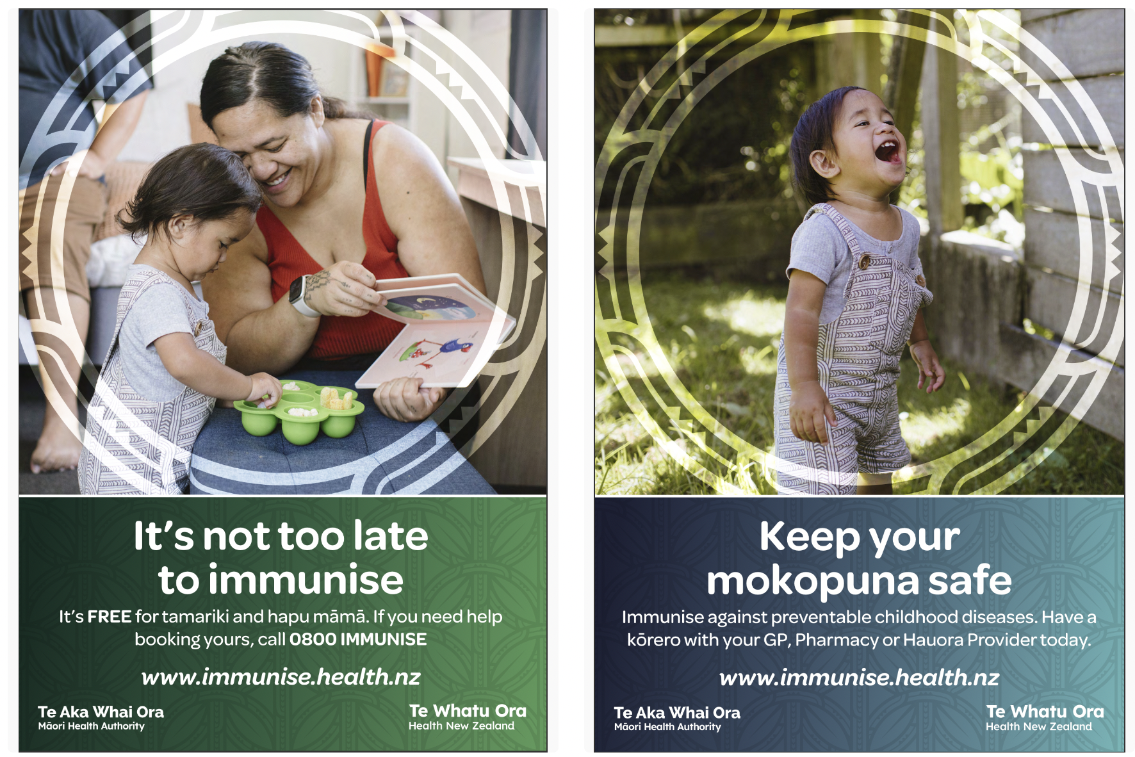
7. Continue to create culturally relevant, positive and credible communications
Parents like the use of “happy smiling and healthy” imagery.
They appreciate the use of “normal everyday whānau who love their pēpē” and it makes them “happy to be Māori”.
Bolding ‘FREE’ is an important reinforcement.
“It’s not too late” is non-judgmental and motivating.
Many indicated that it would motivate them to find out more.
Considerations
Including the phone number on all executions.
A call-to-action around ‘finding more information / answers to your questions may encourage those with concerns around side-effects.
‘Protect your tamariki for life’ creates doubt for some who see it as an ‘over-promise’ or believe boosters are still needed.
Be wary of suggesting that they’re not already taking good care of their tamariki
Source: TRA Supporting Māori parents and caregivers on their immunisation journeys – Apr 2023

Slide 29
There’s appetite to hear from influencers IF they are credible
Social media is seen as a good way to get the word out alongside other media (TV, radio etc.)
Being a serious topic, influencers must signify credibility through:
having their own children / showing tamariki in videos
having knowledge or drawing on credible sources.
Some would like to see relatable, authentic and transparent stories
e.g. how a reluctant family ended up making their decision to immunise.
“Advertising needs to come from "trusted" sources of information, or everyday people that we can relate to, so maybe have an advertisement of a real family who were wary of the immunisations, how they researched them and then chose to immunise their children despite their initial concern.”
Source: TRA Supporting Māori parents and caregivers on their immunisation journeys – Apr 2023

Slide 30
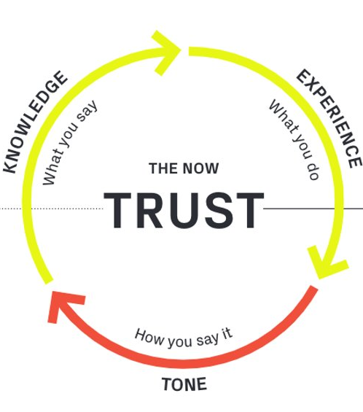
These principles will build trust and support Māori parents/caregivers on their immunisation journey
Sharing clear, positive and balanced information that builds trust and confidence. Setting up the ‘Why’ above the line and directing people to a place that provides further information.
Providing consistent reminders.
Facilitating conversations and immunisations at credible events (e.g. marae or community centres).
Making it easier for those who need home visits or help with the cost of travel.
Communicating with empathy, respect, and positivity across all touchpoints that we can influence
Source: TRA Supporting Māori parents and caregivers on their immunisation journeys – Apr 2023

Slide 31
Summary
COVID has amplified concerns and uncertainty
Many Māori parents/caregivers are open to being encouraged to get their tamariki up-to-date with immunisations if they feel confident and supported.
However, there are currently emotional barriers which have been amplified by the pandemic – distrust, fear and doubt.
There are also practical barriers that are keeping childhood immunisations off people’s radar and making it difficult to get to a health provider.
This means presenting balanced and clear information, making it easy to remember and get immunisations, and treating parents with empathy and respect.
Source: TRA Supporting Māori parents and caregivers on their immunisation journeys – Apr 2023

Slide 32
Communications Considerations

Slide 33
Avoid…
Use…
Language that over-claims efficacy or dictates the solution
‘Prevent’ and ‘Avoid’ create negative reactions because you can’t prevent/avoid getting COVID or Flu and this elicits distrust.
‘Best Protection’ suggests having all of the answers.
Language that confuses or detracts
‘Up to date’ raises too many questions to be immediately persuasive. People are unsure.so makes it in the too hard basket.
Recommendation is to avoid medical jargon where possible.
‘Kick start’ raises associations with ‘kick starting your career’ so the link with immunity/vaccines isn’t easy or obvious.
Use language that signifies how the vaccine works with you
‘Boost your immunity’ and ‘help protect yourself and your whānau’ signify that the vaccine is working alongside you – acknowledging the role that your own body and health habits play.
Further, ‘Help’ resonates because it’s more supportive vs. telling people what to do i.e. ‘protect yourself and your whanau.’
Use language that talks to the benefits of helping to protect yourself and your family
People believe they have already done their bit as part of the team of 5 million and are feeling generally anxious and uncertain.
This means the incentive for getting the Flu and COVID vaccine should be less about ‘the good of the nation’ and more about ‘helping to protect yourself and your family’.
‘Help protect yourself and your whānau this winter’ resonates because it captures this strong personal and emotional incentive.
Source: Flu and COVID-19 Winter 23 Qualitative Research

Slide 34
Reminders
‘Immunisations’ are linked with MMR and kids.
‘Vaccinations’ is the more expected and easily understood language for COVID and Flu.
‘Bugs’ are something children get – this doesn’t capture the seriousness of COVID or Flu.
There’s not a big difference between ‘shots’ and ‘jabs’, though ‘jabs’ is more strongly associated with Flu.
‘Booster’ is COVID language. It brings up negativity for some i.e. ‘I’ve had my vaccine and a booster, surely I must be immune by now.’
However, ‘boost’ is more positive as it implies your agency of caring for your health.
‘Winter Wellness’ is too vague and posh/uppity/exclusive – lacking relevance particularly for Māori.
Source: Flu and COVID-19 Winter 23 Qualitative Research

Slide 35
Humour – when and where to use it
Humour can be a powerful tool in creating work that stands out, is enjoyable and memorable
We tested ‘It Sucks Being Sick’ as one of our messages to get a steer on how our audience would react to a more humourous approach.
Participants were comfortable with a humorous approach for Flu and vaccines generally.
It resonated particularly well with a younger/general population audience – getting a positive reaction.
However, COVID is still too raw emotionally for a humorous approach to be appropriate.
This was particularly true for Māori who saw COVID as still being very serious and didn’t want the topic approached in an overly casual way.

Slide 36
Māori are more engaged with Māori channels
Māori re COVID
+/- vs. total
+8
-4
+3
+2
+1
+1
-5
-15
+12
+9
+3
-3
+9
-3
+1
-1
-1
-3
+/- vs. total
+1
-1
-2
+6
+3
+2
+9
+4
-2
+2
-1
+1
-1
Source: Booster Reframe August 2022
Q. Where would you normally get information about COVID-19 boosters?
Q. When it comes to talking about COVID-19 boosters, who are the types of people / groups you want to listen and talk to?
Base: Māori n=52
Significantly higher/lower than total sample

Slide 37
GP or health care provider still key for Pacific
Pacific re COVID
Source: Booster Reframe August 2022
Q. Where would you normally get information about COVID-19 boosters?
Q. When it comes to talking about COVID-19 boosters, who are the types of people / groups you want to listen and talk to?
Base: Pacific n=29
Significantly higher/lower than total sample

