Slide 1
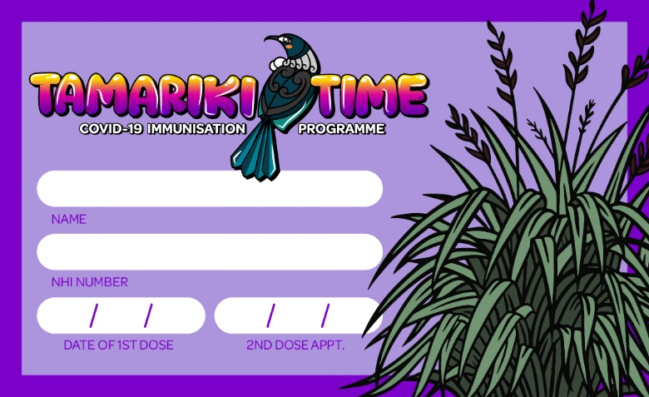
Tamariki Second Appointment Card
Business Card sized card given to the child after their first dose, with the date written, eight weeks from that day’s date when they will be eligible for their second dose.

Slide 2
Tamariki Immunisation Certificate
Given after the immunisation. If the immuniser can write the name and date along with the appointment card, and put one sticker on the certificate.
The second sticker will be given when the child comes back in for their second dose.

Slide 3
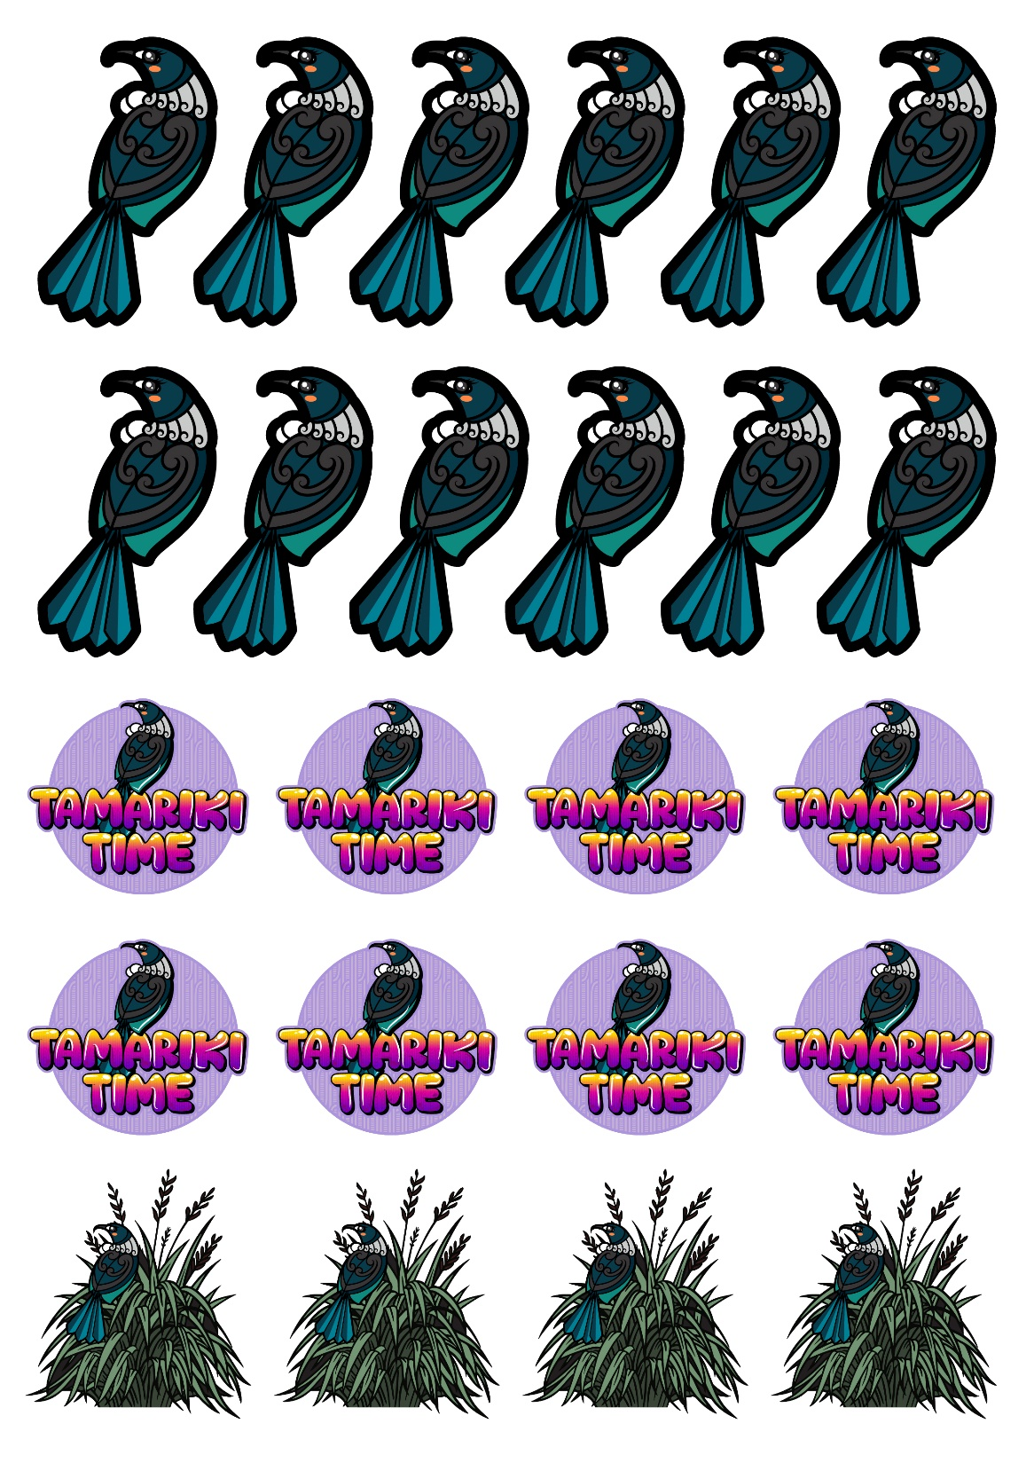
A4 Sticker Sheet
Tui stickers are the right size to stick onto the certificate, one per dose.
Other sticker designs to be given out to all children as needed, they don’t need to be getting the immunisation in order to get the stickers.

Slide 4
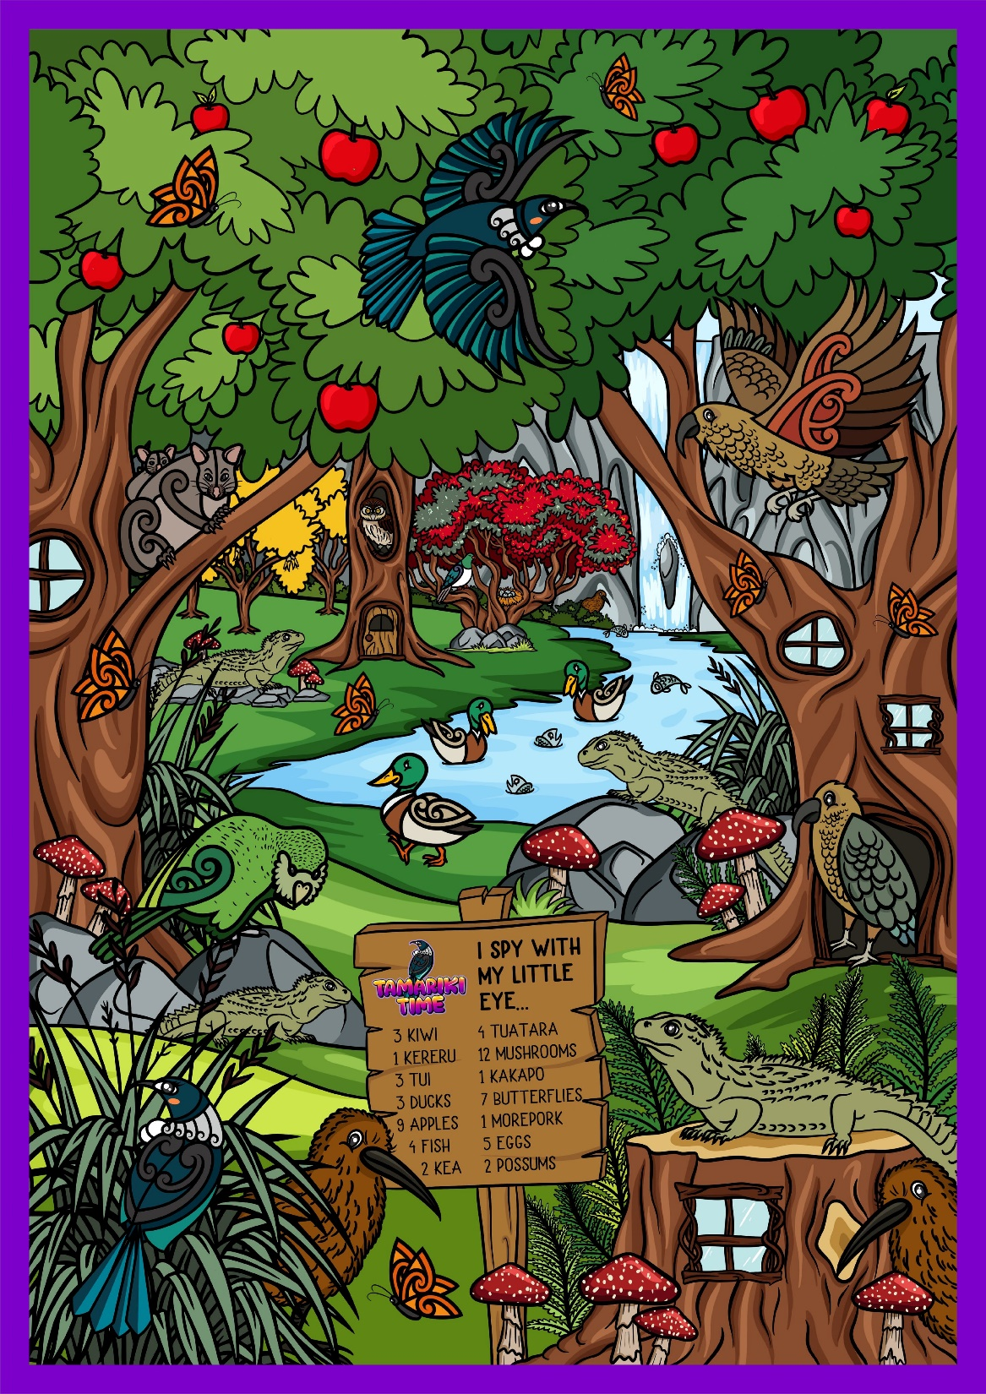
Immunisation Distraction Mural
Produced in either A2, A1, or A0 poster sizes, this mural sits on the wall opposite the child as they are being immunised to give them something to focus on and play I Spy for the different features as suggested by the immuniser.

Slide 5
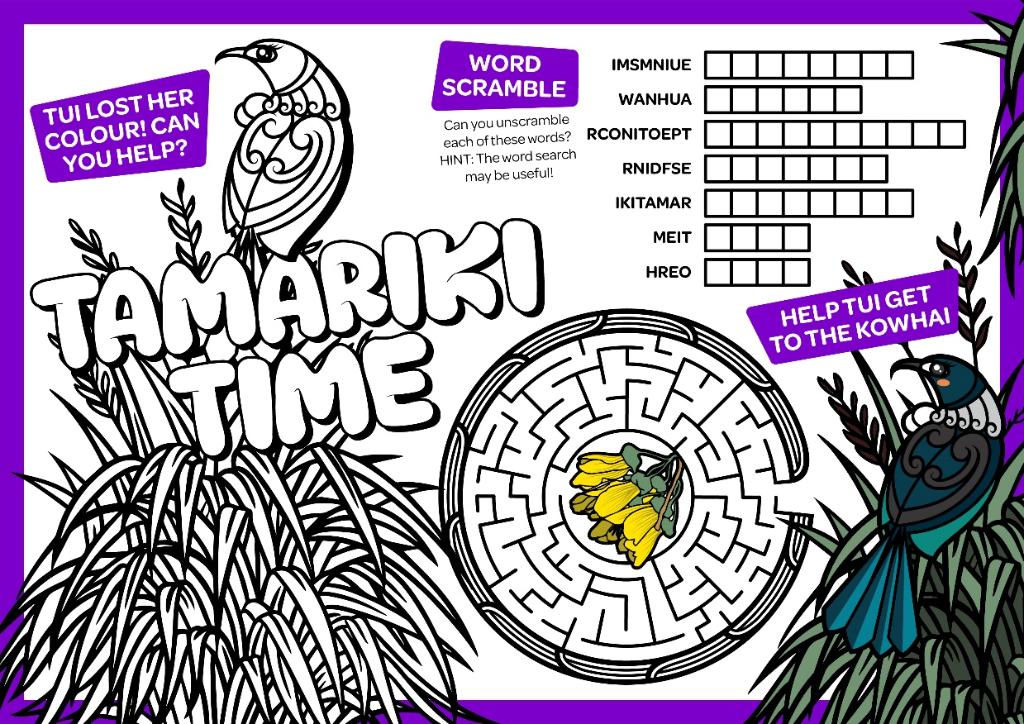
A4 Activity Sheet
Double sided activity sheet given to children after their immunisation to do while they’re waiting in the observation area.
Also can be available in the Whānau Waiting Area for other children.

Slide 6
Large Format Decoration Decals
A0 printed decal sheet with multiple stickers that can be used to decorate existing vaccination booths and walls with Tamariki Time branding to help kids feel that the space is made for them.
We have stuck these up at “kid height” on entryways and info desks.

Slide 7
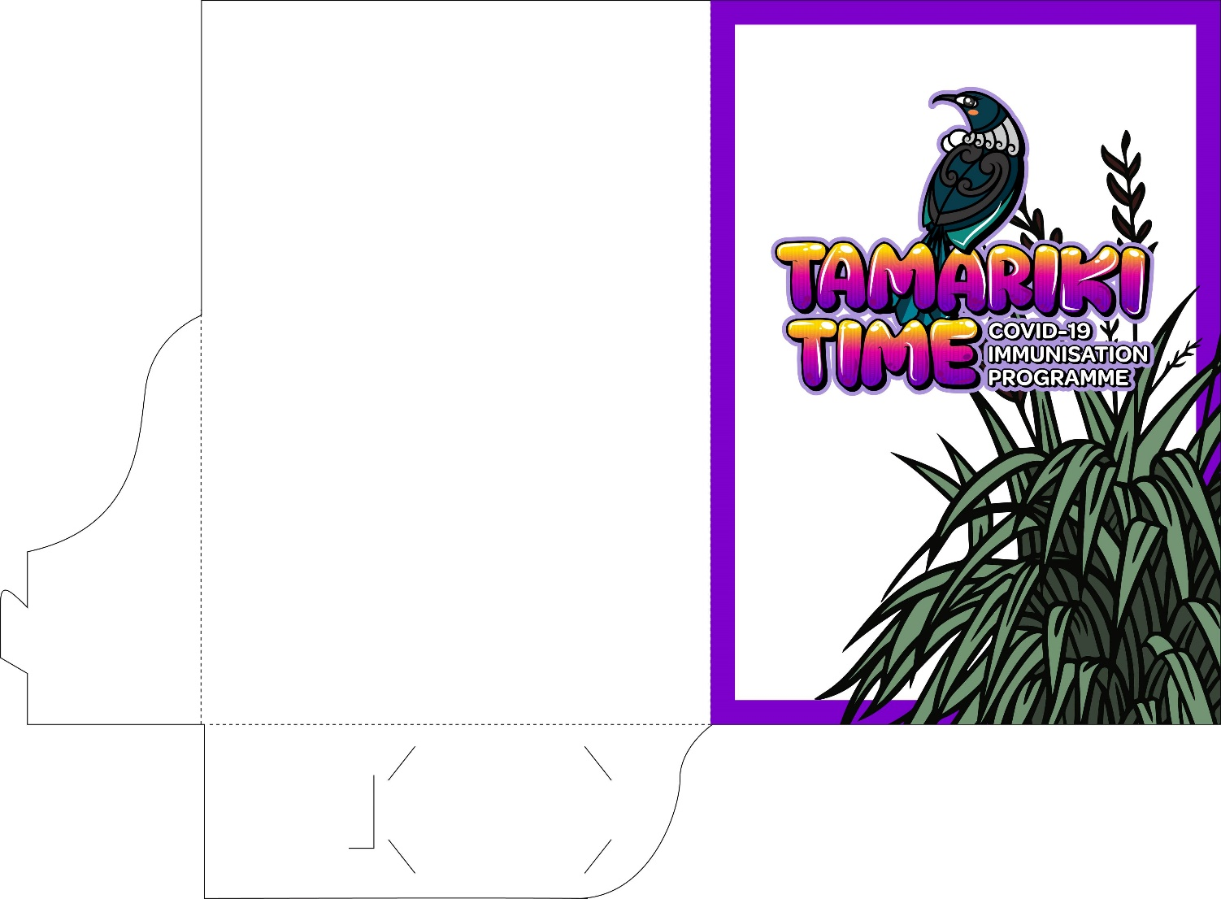
A4 Tamariki Time Folder
Open pocket folder that allows us to give parents information pertaining to the COVID-19 immunisation (for parents who have come to outreach events looking for info to help make their decision).
Open pocket allows for our provider partners to put in other health and wellbeing info alongside the COVID-19 info.

